Slide 1

Name: Mahmoud Mostafa Tayee C project Udacity, FWD Payment Application

Slide 2
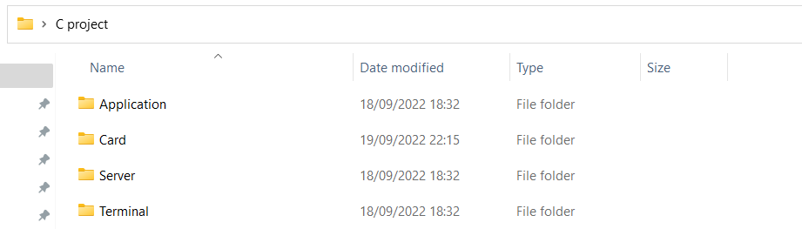
1- Create modules folder

Slide 3
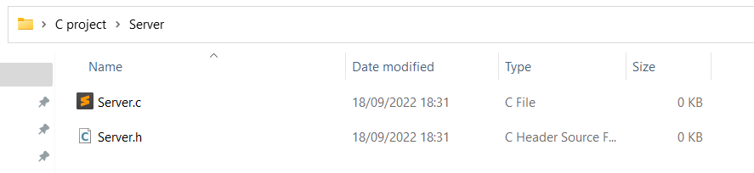
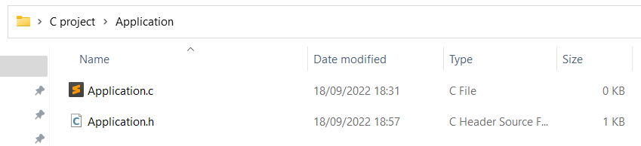
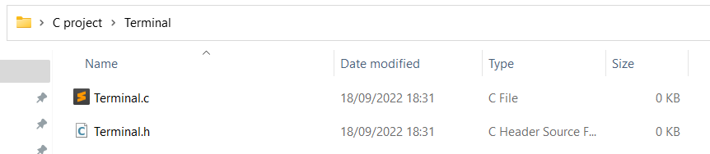
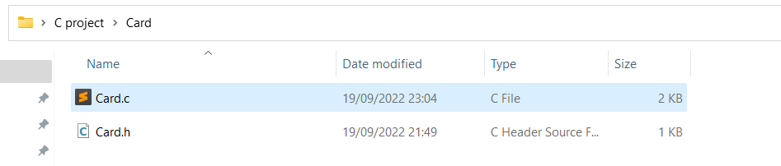
2- Create .c and .h file for each module

Slide 4
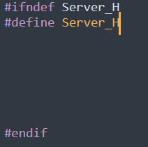
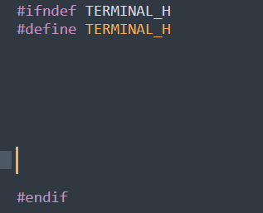
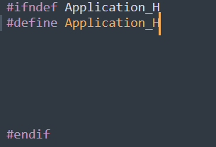
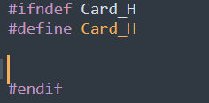
3- Add header file guard

Slide 5

The Card Module

Slide 6
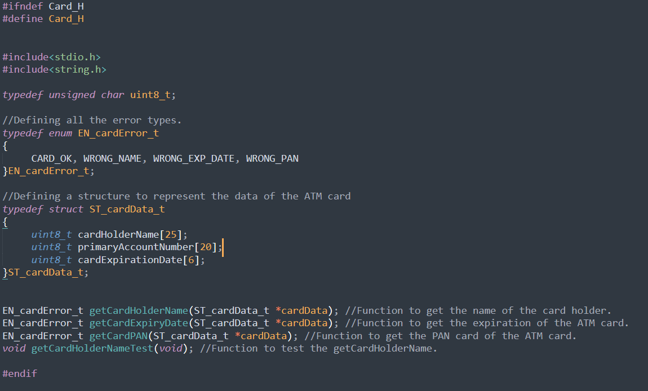
4- Fill in card.h file with functions' prototypes and typedefs

Slide 7
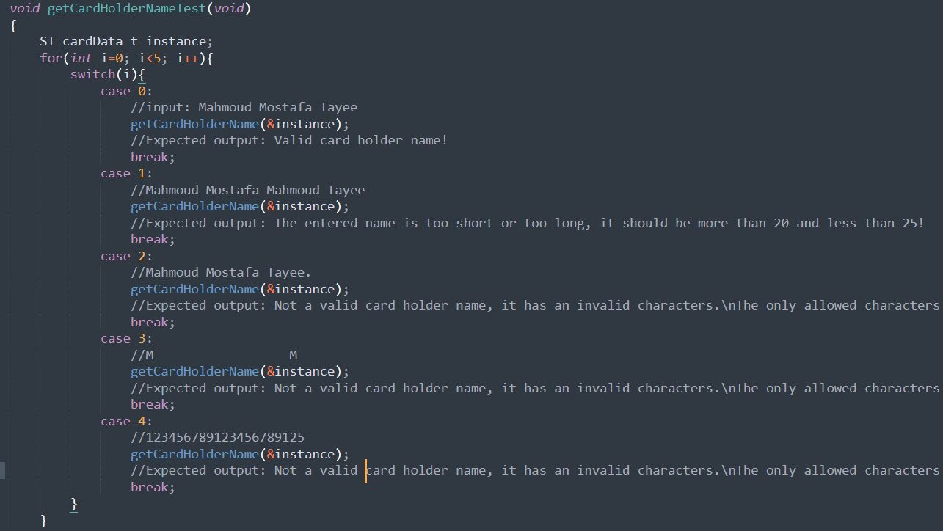
5- Implement getCardHolderName function (The test function)

Slide 8
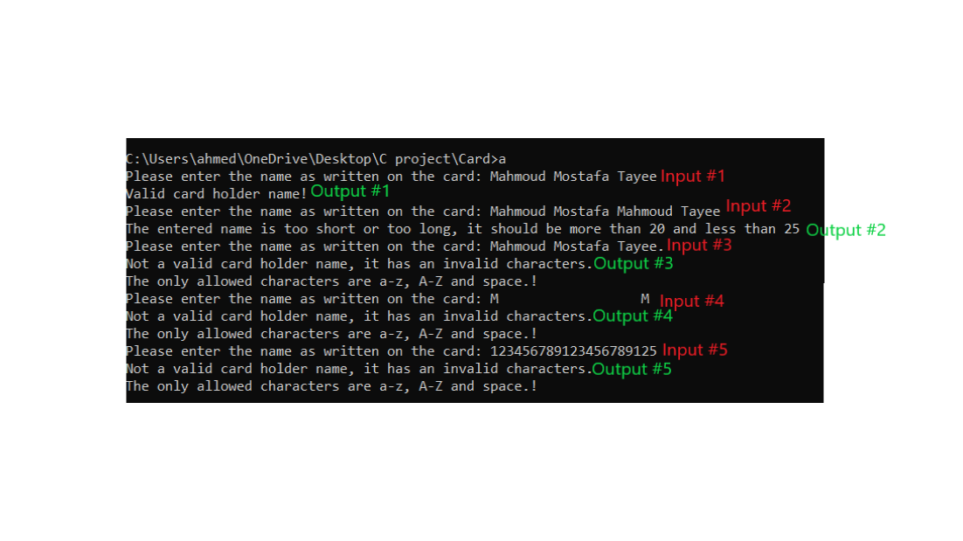
5- Implement getCardHolderName function (the results on the console)

Slide 9
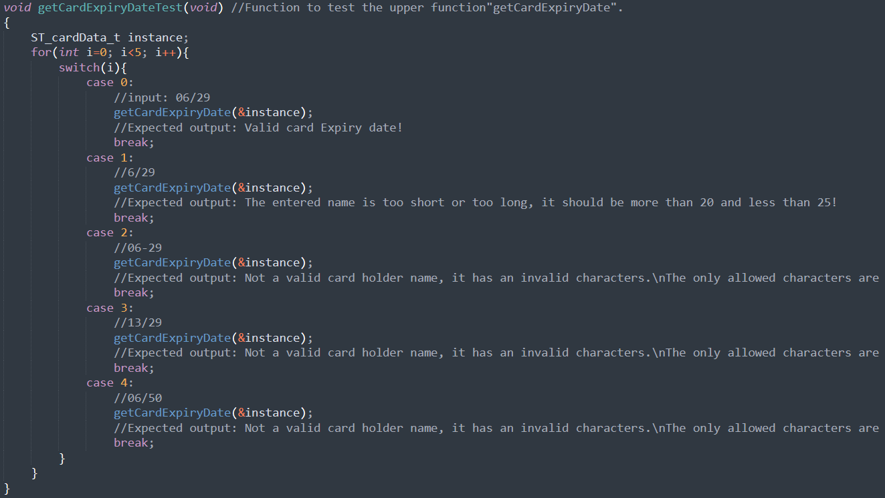
6- Implement getCardExpiryDate function (The test function)

Slide 10
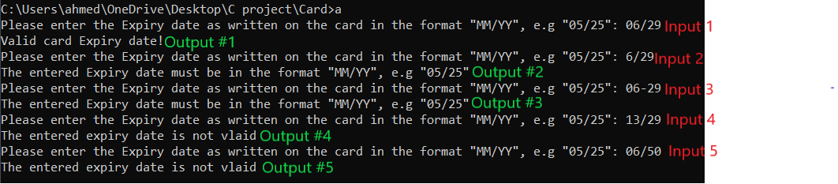
6- Implement getCardExpiryDate function (The results on the console)

Slide 11
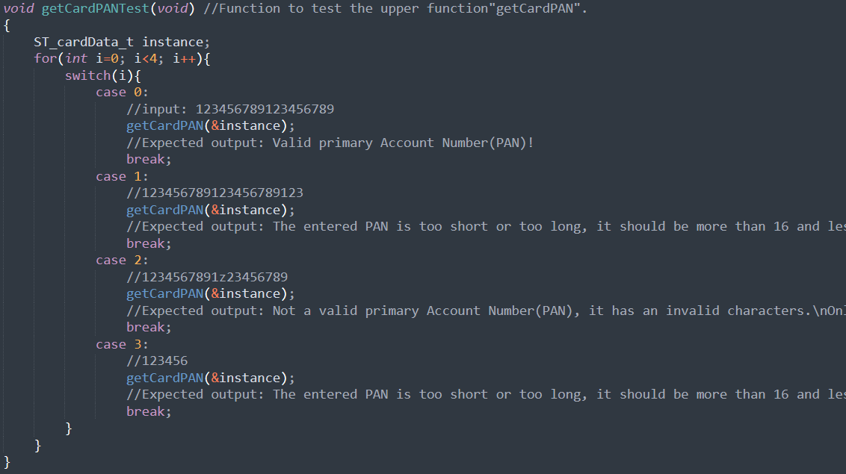
7- Implement getCardPAN function (The test function)

Slide 12
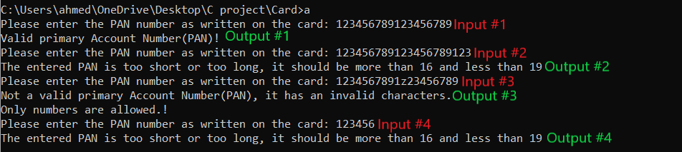
7- Implement getCardPAN function (The results on the console)

Slide 13

The Terminal Module

Slide 14
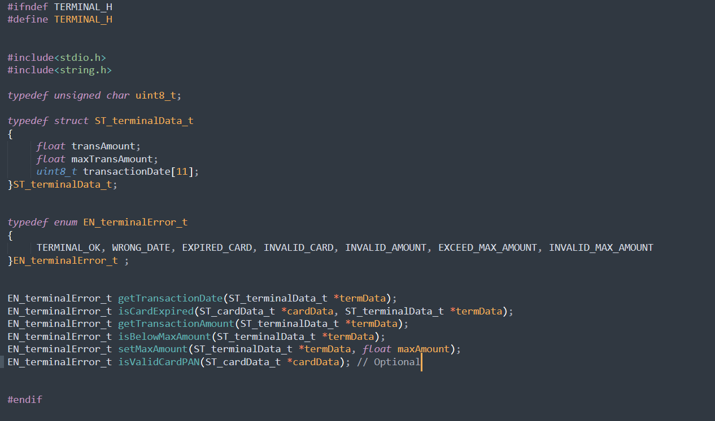
8- Fill in terminal.h file with functions' prototypes and typedefs

Slide 15
9- Implement getTransactionDate function (The test function)

Slide 16
Implement getTransactionDate function (The results on the console.)

Slide 17
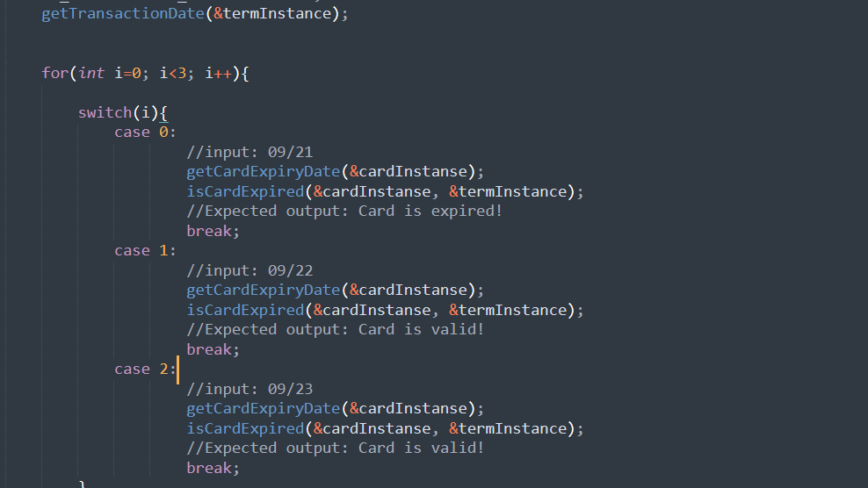
10- Implement isCardExpried function (the test function)

Slide 18
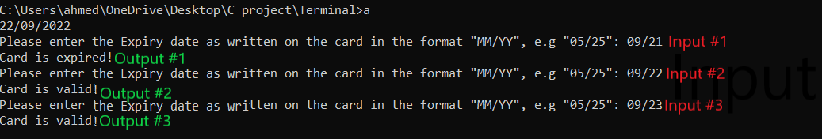
10- Implement isCardExpried function (The results on the console.)

Slide 19
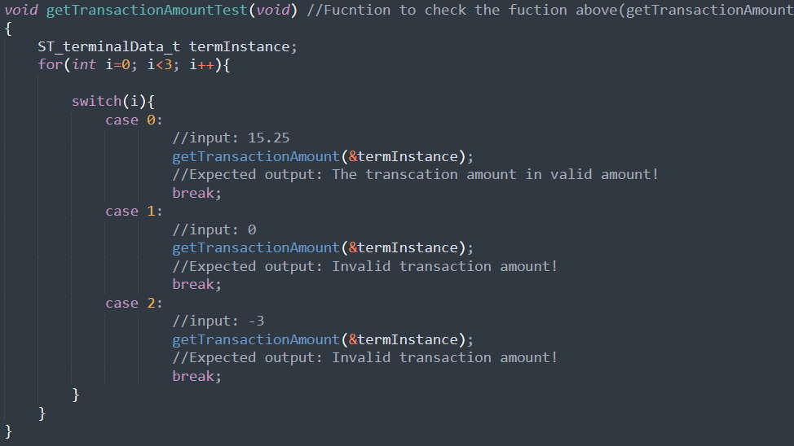
11- Implement getTransactionAmount function (the test function)

Slide 20
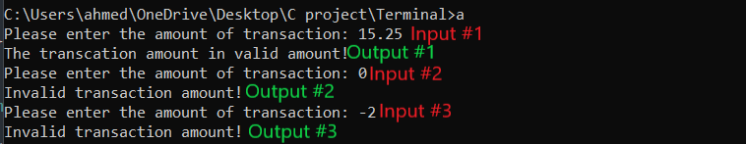
11- Implement getTransactionAmount function (The results on the console)

Slide 21
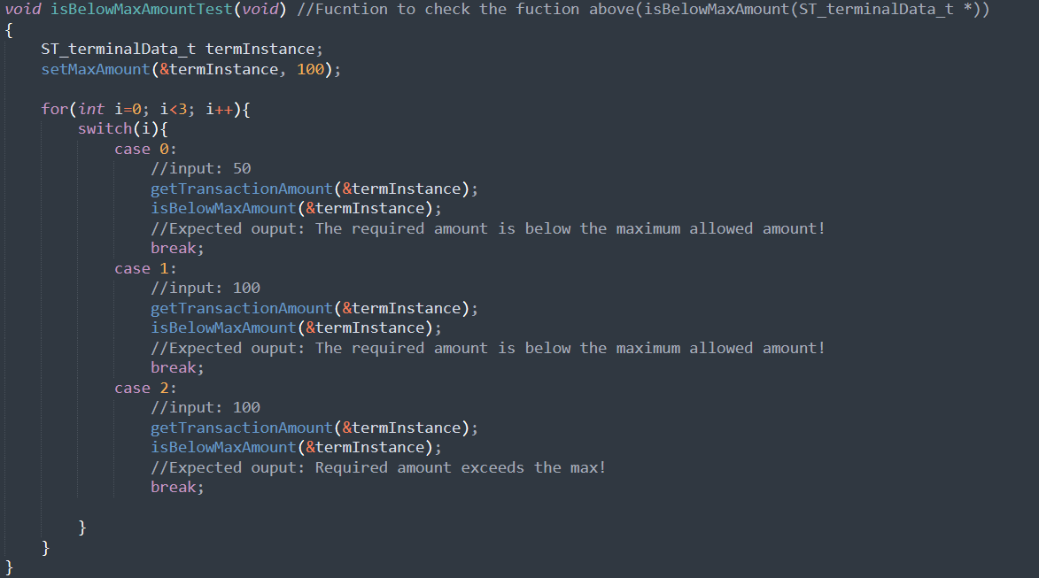
12- Implement isBelowMaxAmount function (The test function)

Slide 22
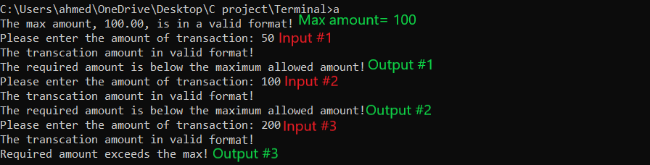
12- Implement isBelowMaxAmount function (12.2 The results on the console)

Slide 23
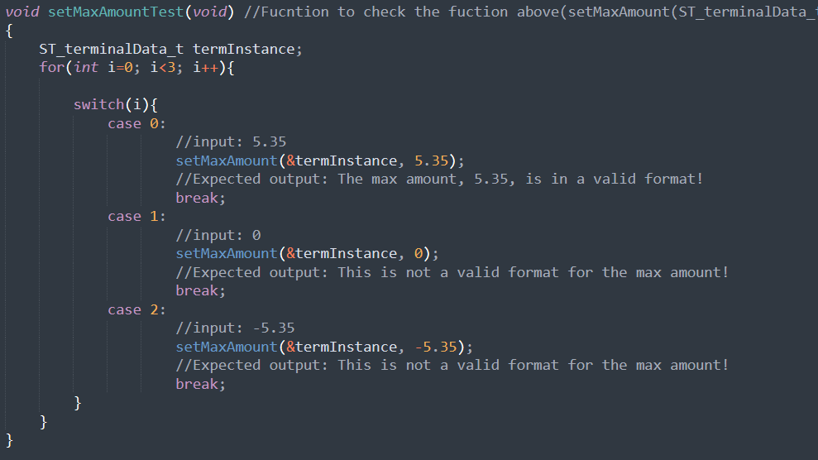
13- Implement setMaxAmount function. (the test function)

Slide 24

13- Implement setMaxAmount function (The results on the console)

Slide 25
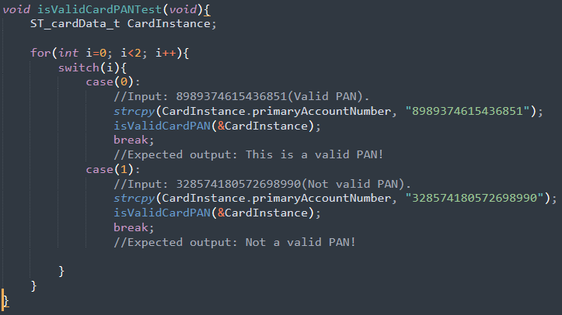
14- Implement isValidCardPAN function (Optional) (the test function)

Slide 26

14- Implement isValidCardPAN function (Optional) (The results on the console.)

Slide 27

The Server Module

Slide 28
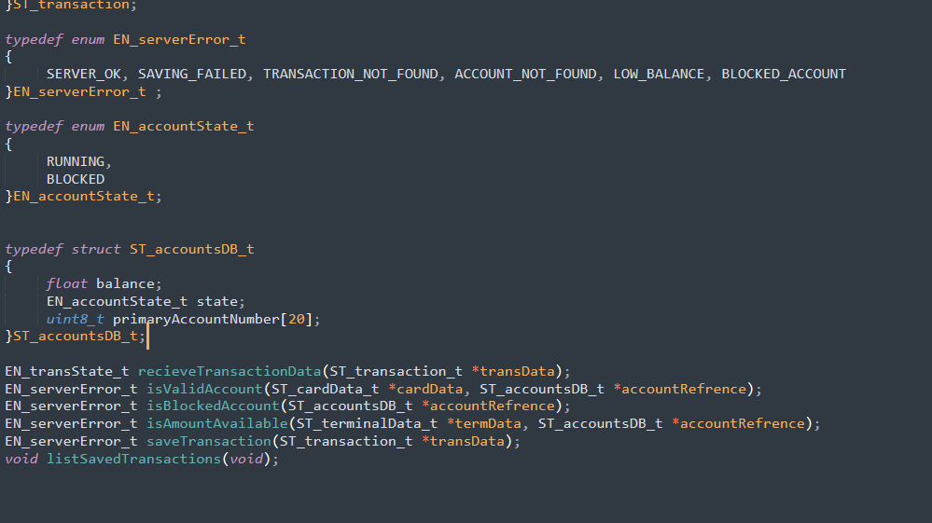
15- Fill in terminal.h file with functions' prototypes and typedefs

Slide 29
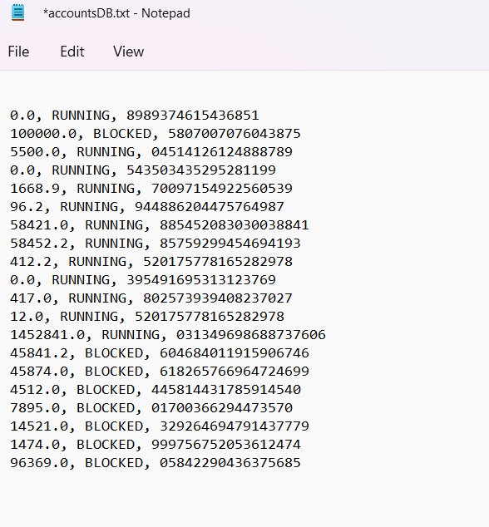
16- Implement server-side accounts' database.

Slide 30
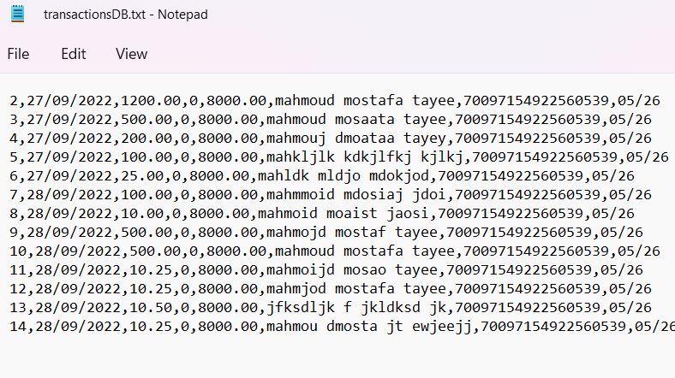
17- Implement server-side transactions' database.

Slide 31
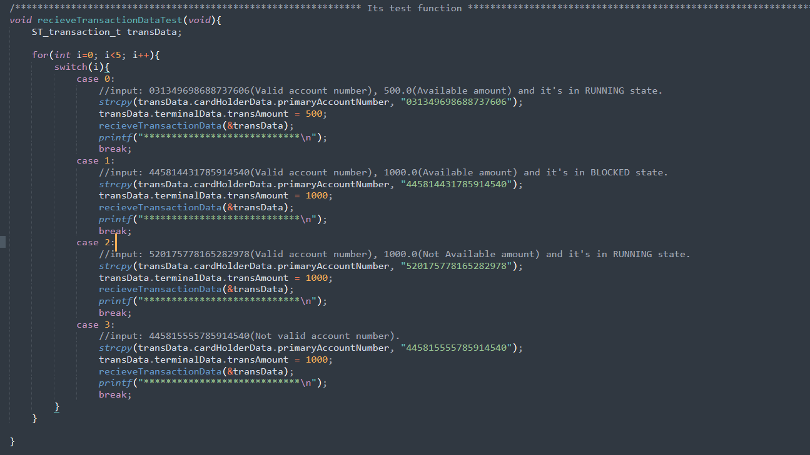
18- Implement recieveTransactionData function (The test function)

Slide 32
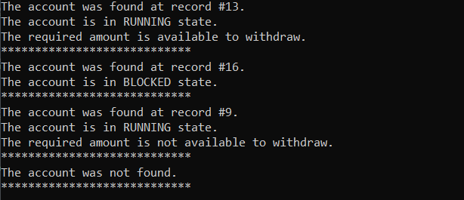
18- Implement recieveTransactionData function (The results on the console)

Slide 33
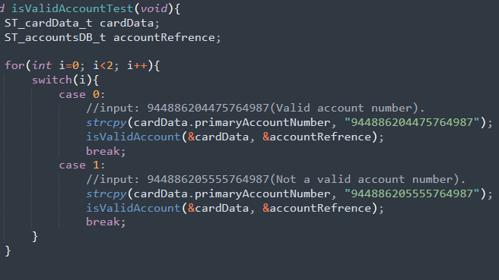
19- Implement isValidAccount function (The test function)

Slide 34

19- Implement isValidAccount function (The results on the console.)

Slide 35
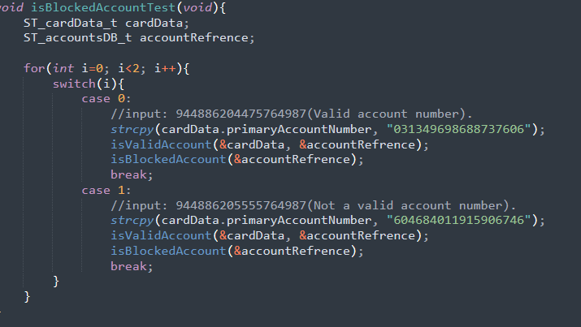
20- Implement isBlockedAccount function (The test function)

Slide 36
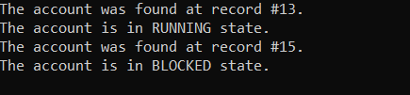
20- Implement isBlockedAccount function (The results on the console)

Slide 37
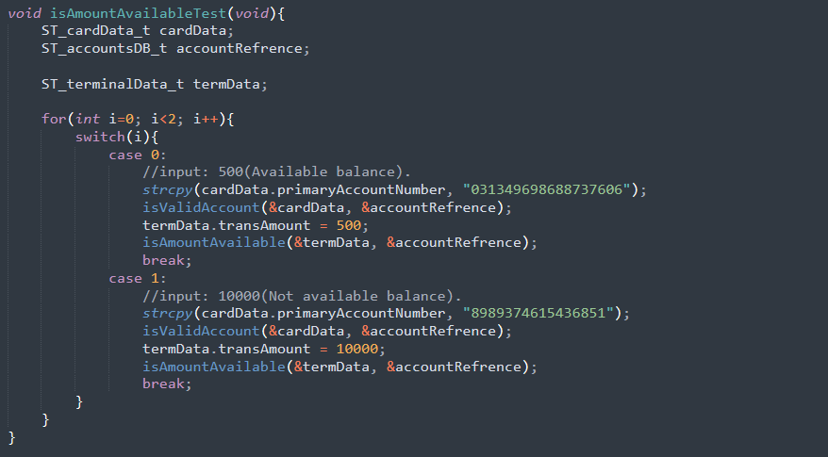
21- Implement isAmountAvailable function (The test function)

Slide 38

21- Implement isAmountAvailable function (The results on the console)

Slide 39
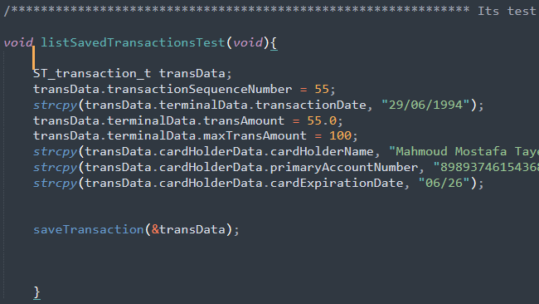
22- Implement saveTransaction function (The test function)

Slide 40
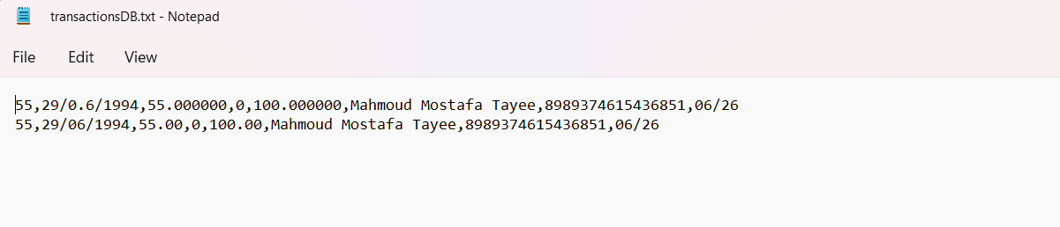
22- Implement saveTransaction function (The results on the console)

Slide 41
23- Implement listSavedTransactions function (The test function)

Slide 42
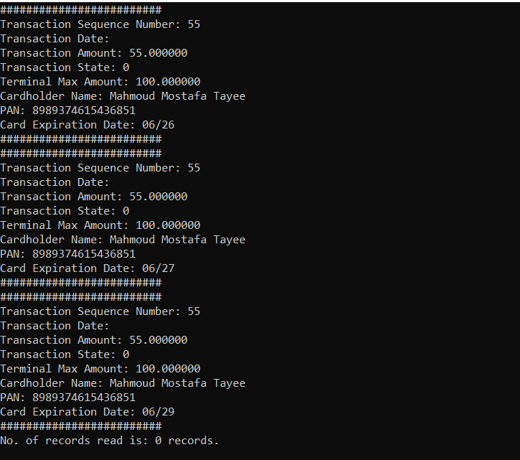
23- Implement listSavedTransactions function (The results on the console)

Slide 43
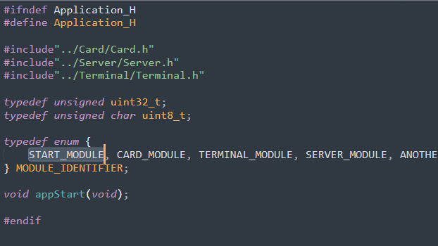
24- Fill in application.h file with functions' prototypes

